Slide 1

DEPARTMENT OF ARTIFICIAL INTELLIGENCE AND DATA SCIENCE
Artificial Neural Networks and Deep Learning: 21ADG64
LA1 - Seminar
Title: Skip Gram Architecture
Presented By
Shreya
1NT21AD048
Name of the Course Instructor
Dr Meenakshi

Slide 2
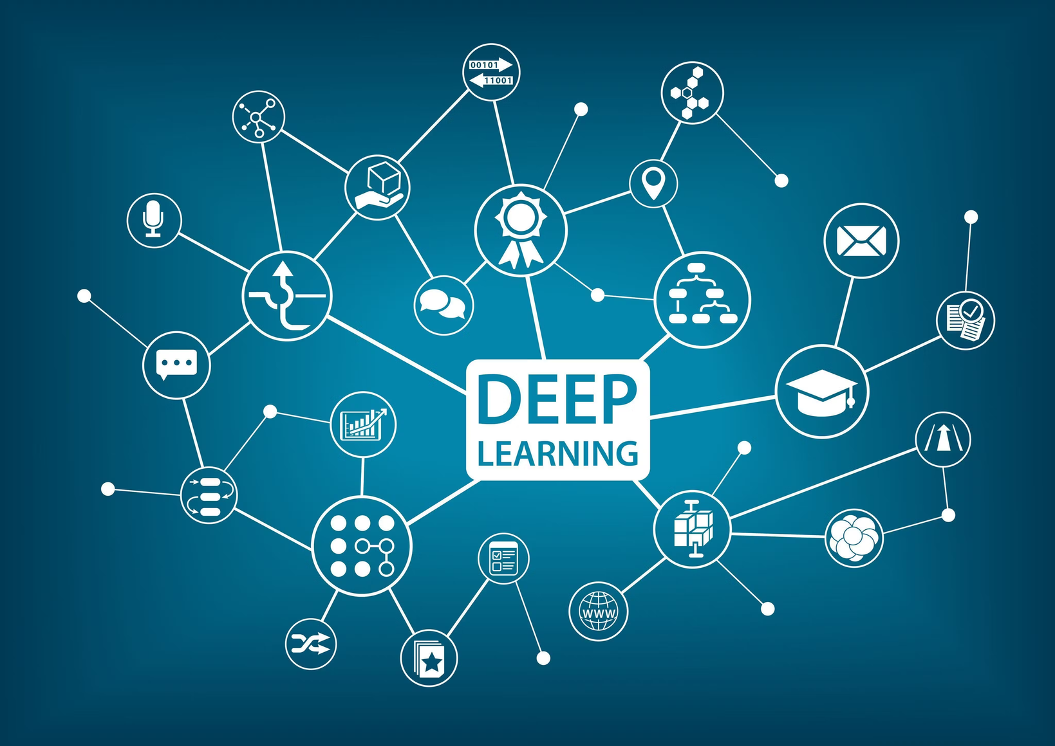
Table
of Content
Introduction and Motivation
Conclusion
Methodology and
Approach
Future Directions
Results
Github link of PPT and code
Analysis
References

Slide 3
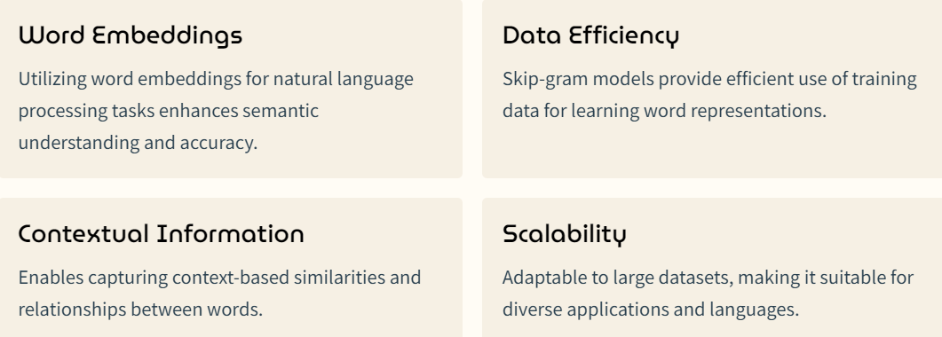
Introduction to Skip Gram Architecture and Motivation for Using Skip Gram
The Skip-gram architecture is a fundamental component of word embedding models, particularly popularized by the Word2Vec algorithm developed by researchers at Google. Word embeddings are dense vector representations of words in a continuous vector space, where words with similar meanings are represented by vectors that are close together.

Slide 4

Methodology of Skip Gram
1.Data Collection: Gather a large corpus of text data from diverse soWord
2.Embedding: Convert words into vectors using techniques like Word2Vec
.
3.Training the Model: Utilize neural networks to train the skip-gram model
for learning word representations.
4.Evaluation: The quality of the learned word embeddings can be
evaluated using various tasks such as word similarity, analogy completion,
or downstream NLP tasks like text classification or sentiment analysis.
5.Fine-tuning: Depending on the specific requirements, the learned
embeddings can be further fine-tuned on a downstream task-specific
dataset to enhance performance

Slide 5
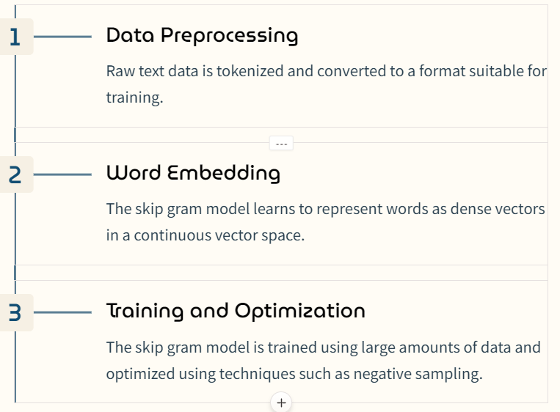

Approach for Implementing Skip Gram

Slide 6

Results of Skip Gram Model
The skip-gram model generates high-quality word embeddings with
rich semantic information.
It successfully captures word relationships and demonstrates improved
performance in various natural language processing tasks.
The embeddings were versatile, enabling effective representation of
diverse linguistic features.
Skip-gram models can be pre-trained on large corpora and then fine
tuned on specific tasks or datasets, which is a common practice in
transfer learning for NLP.

Slide 7
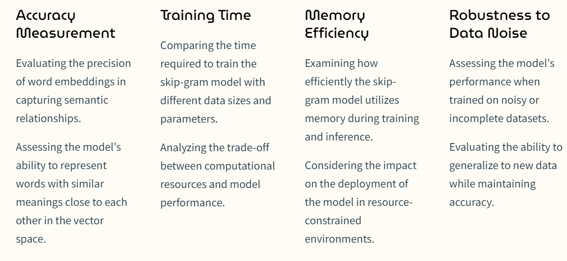
Analysis of Skip Gram Performance

Slide 8
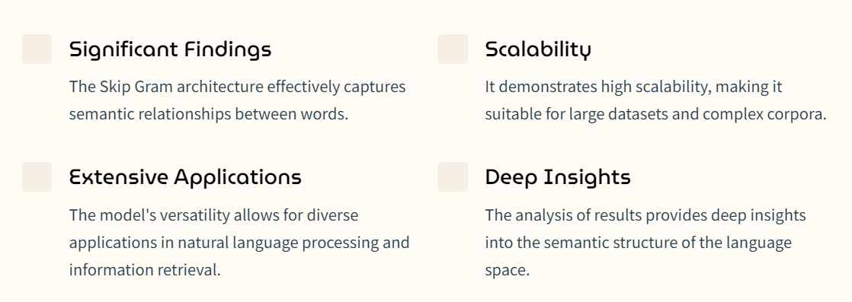
Conclusion and Key Findings

Slide 9
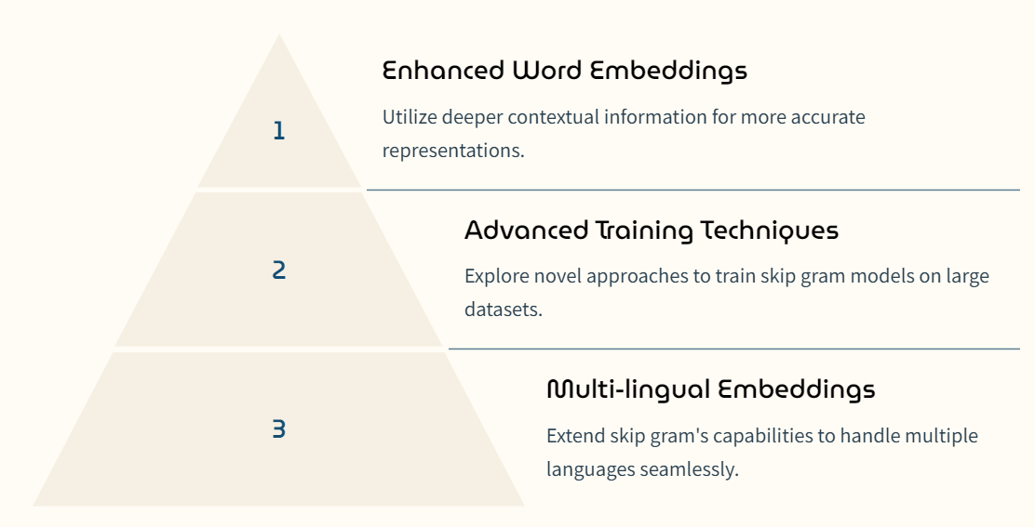
Future Directions for Skip Gram

Slide 10
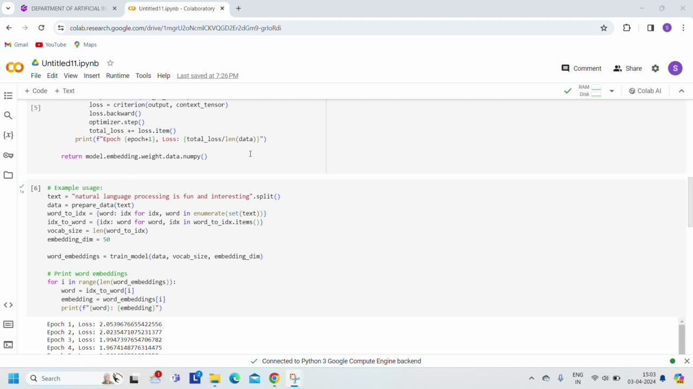
Demo video of code:

Slide 11
References and Github link
https://www.youtube.com/watch?v=lEzzgLh_SFA
2. https://www.youtube.com/watch?v=G5ah0QqkUgE
3. https://towardsdatascience.com/skip-gram-nlp-context-words-prediction-algorithm-5bbf34f84e0c
4. Chatgpt

